Slide 1



Active Flow Control over an Airfoil with Nanosecond Pulse Driven DBD Plasma Actuators
Keith Sangston
Undergraduate Research Intern
Jesse Little
Assistant Professor, Department of Aerospace
and Mechanical Engineering
The University of Arizona
April 21, 2012

Slide 2
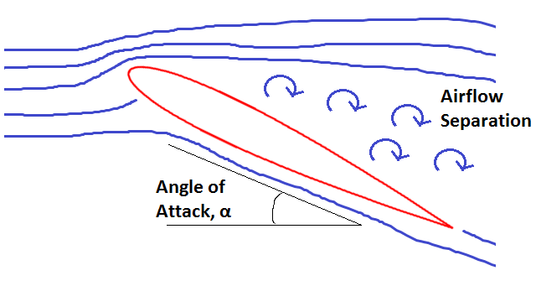
Problem
2
At large angles of attack, the wings of an aircraft will experience stall. This results in…
Airflow separation
Reduced lift
Increased drag
Decreased aircraft control

Slide 3
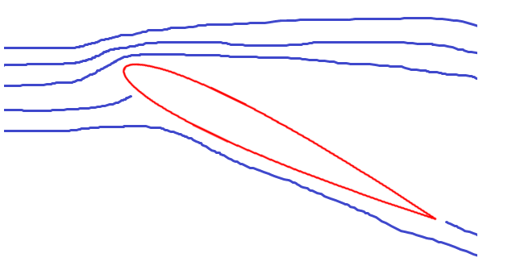
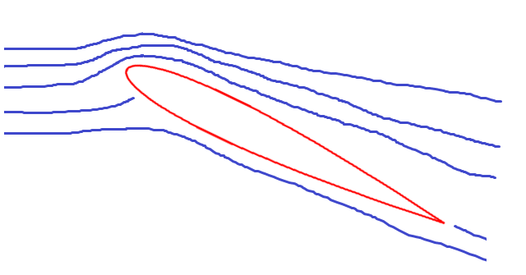
Nanosecond DBD plasma actuators
3
Plasma actuation…
Increases lift
Increases aircraft control
Decreases drag
Decreases airflow separation
Reduced airflow
separation
Without DBD Actuation
With DBD Actuation

Slide 4
Goal
4
Better understand the physics behind the use of nanosecond pulse driven dielectric barrier discharge (DBD) plasma actuators to control the airflow around an airfoil
Dominant mechanism believed to drive phenomenon:
Thermal energy transfer from discharge

Slide 5
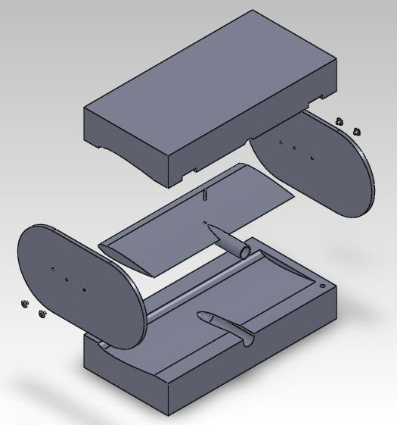
Airfoil construction - Design
5
MAJOR PARTS:
Molds
Polyurethane casting resin
Wind tunnel mount
Endplates
Designed in SolidWorks (Computer-Aided Design program)
1
3
2
4

Slide 6
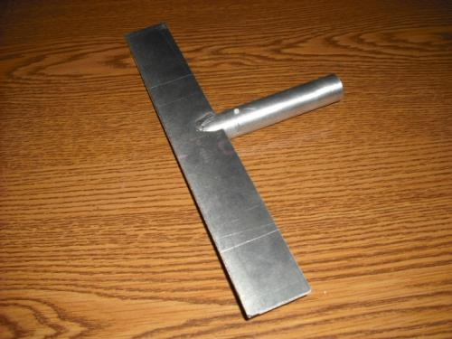
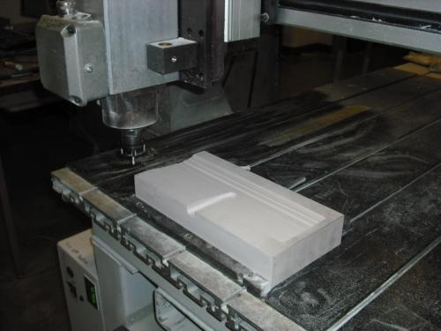
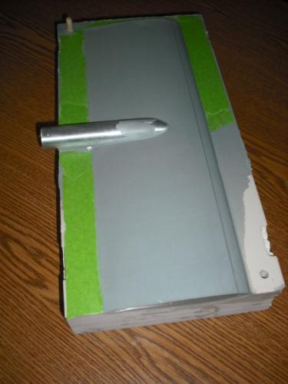
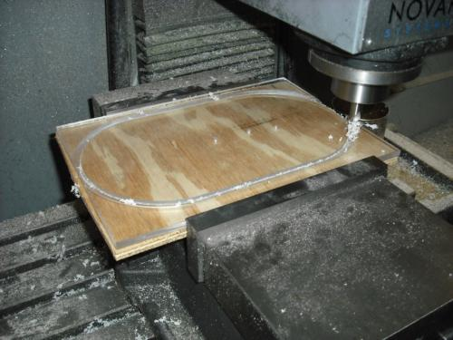
Airfoil construction - Manufacture
6
Molds
(Router)
Casting
(Polyurethane)
Mount & Support
(Metalworking)
Endplates
(CNC)

Slide 7
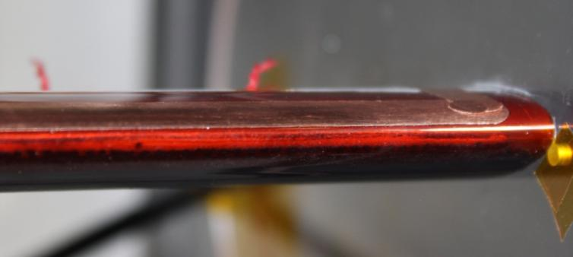
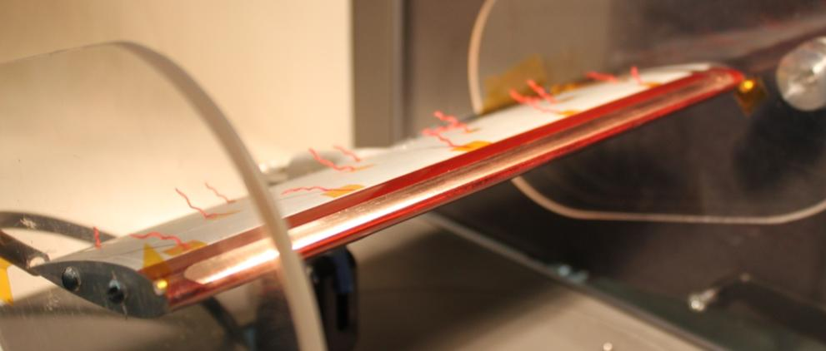
DBD plasma actuator
7
High voltage electrode
Covered, grounded electrode
Kapton tape dielectric barrier
3
1
2
Dielectric:
Insulator that may be polarized by an electric field

Slide 8
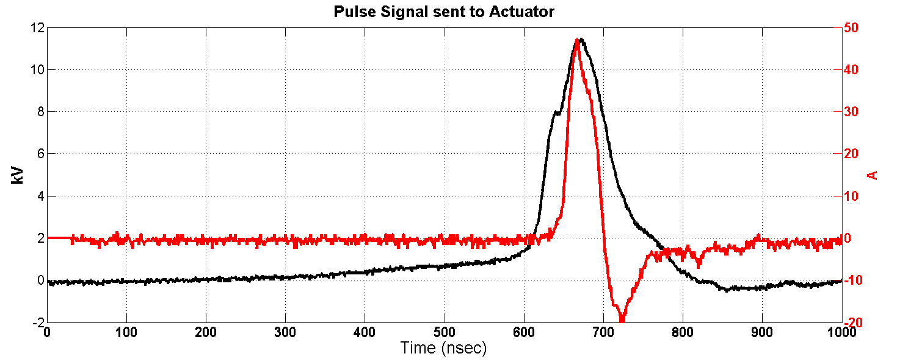
Electrical signal input
8
Peak ≈ 12 kV
Time of rise and fall ≈ 100 ns
SOURCE: Rob Dawson, Graduate Student, University of Arizona

Slide 9
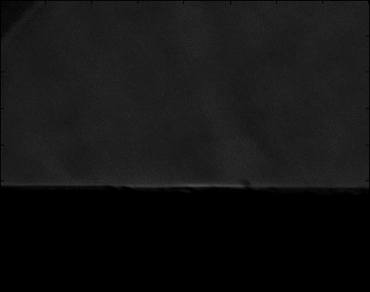
Thermal mechanism - Shockwave
9
Schlieren imaging (0-20 µs)
Schlieren imaging is used to visualize flows of fluids due to varying densities
Rapid localized heating
Shockwave propagates outward
SOURCE: Rob Dawson, Graduate Student,
University of Arizona

Slide 10
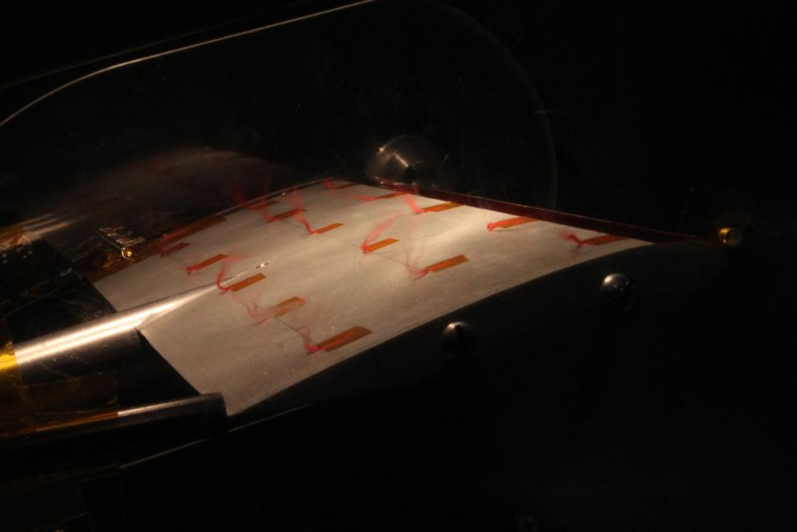
Flow visualization
10
Method: Tufts (unwound yarn)
Longer exposure
shows movement
of tufts, which
indicates stall
Actuation: OFF

Slide 11
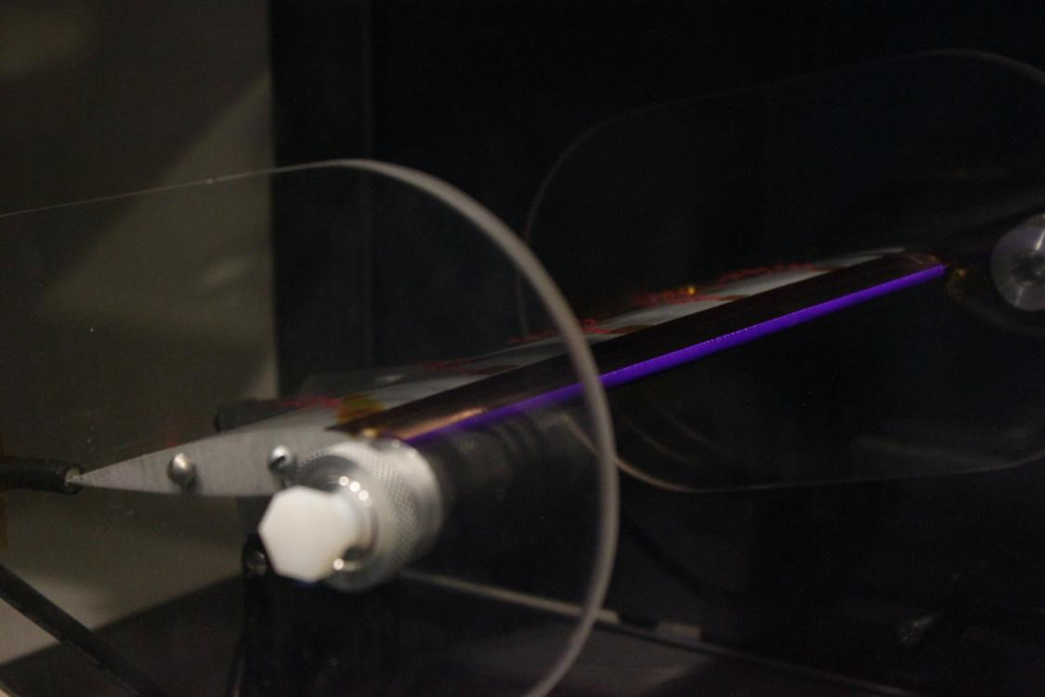
Flow visualization
11
Tufts laying flat
Plasma forms
On leading edge

Slide 12
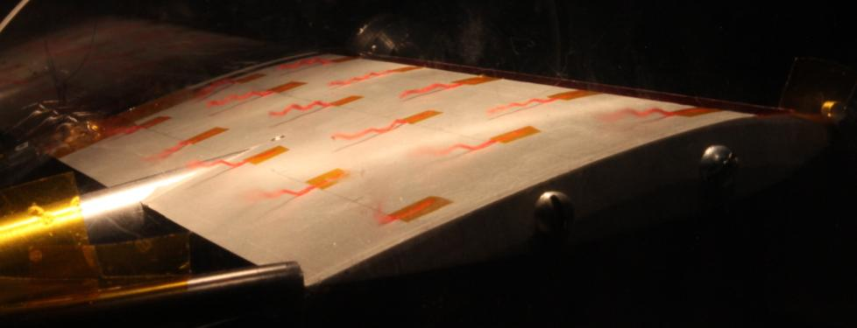
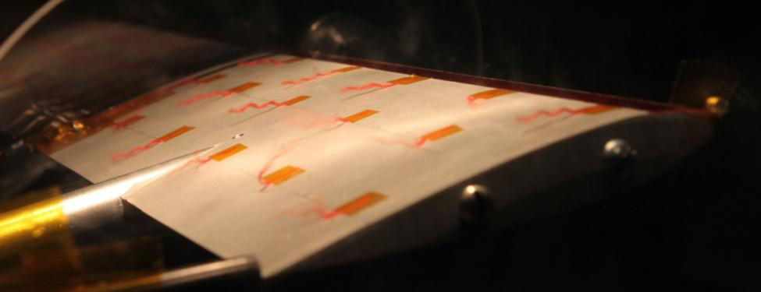
Flow visualization: Actuation ON
12
Angle of Attack:13°
Frequency: 650 Hz
Voltage:500 V
Angle of Attack:15°
Frequency: 1250 Hz
Voltage:500 V

Slide 13
Flow visualization
13
Angle of Attack:
13°
Frequency:
650 Hz
Voltage:
500 V

Slide 14
Concluding remarks
14
Results:
Tufts going flat during actuation illustrate airflow reattachment
Driving frequency dependent on angle of attack
DBD plasma actuation positively affects airfoil performance
Potential benefits of DBD actuation:
Increased safety
Lighter, more efficient aircraft
Require relatively low power
Other airflow control applications

Slide 15
Future steps
15
Force measurements
Lift, drag, pitching moment
Quantify effects of DBD plasma actuation
Experimentation with resistors
Changes rise time of signal
Varies thermal effects of actuation

Slide 16
16
Thank you for your attention!
Special thanks:
Susan Brew & Barron Orr
Jesse Little
Intern advisors

Slide 17
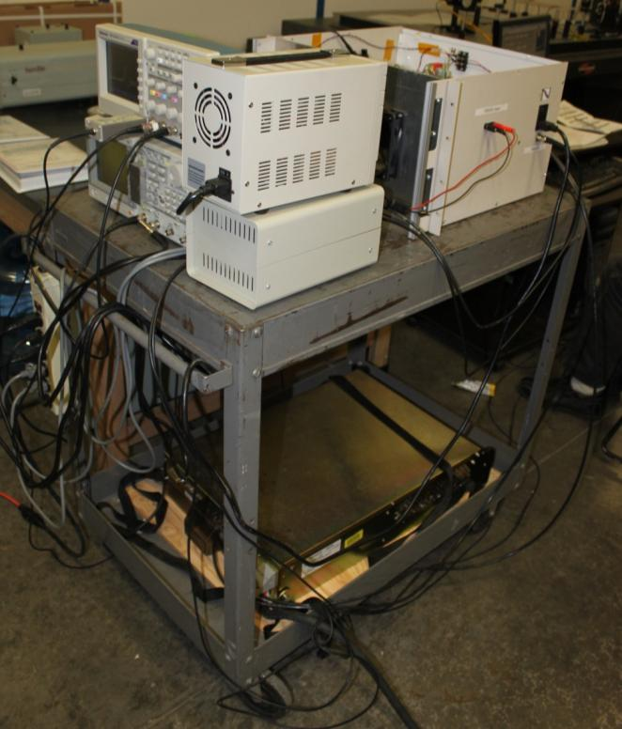
Electrical setup
17
Oscilloscope
Function generator
120V-1A DC Power supply
Controller unit
Main unit
DC Power supply
1
3
2
5
4
6

Slide 18
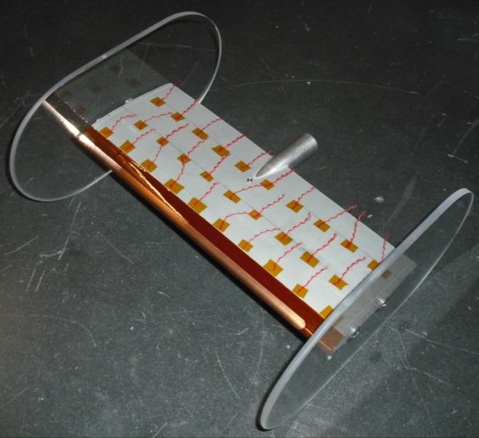

Airfoil construction
18
NACA 0015 airfoil chosen
t
Chord
Chord is distance between leading edge and trailing edge
‘00’ = Symmetric shape
‘15’ = Max thickness, t, is 15% of chord length

